Slide 1
DATA 624
Association Rules
Joby John
Mike Gankhuyag
Albina Gallyavova

Slide 2
Table of Contents
Association Rules
Market Basket Analysis
Apriori Algorithm
Overview
Measures of Interestingness - Support, Confidence, Lift
R implementation
Conclusion

Slide 3
Association Rules
Rule-based machine learning method for discovering interesting relations between variables in large databases
If-then statements that help to show the probability of relationships between data items
A → B[Support,Confidence]
Computer -> Anti-virus Software[Support=20%,confidence=60%]
{Diaper} → {Beer}
Marketing, Basket Data Analysis (or Market Basket Analysis) in retailing, bioinformatics, medical diagnosis, Web mining, and scientific data analysis
Analysis of credit card purchases, Identification of fraudulent medical insurance claims
Notes:
20% transaction show Anti-virus software is bought with purchase of a Computer
60% of customers who purchase Anti-virus software is bought with purchase of a Computer

Slide 4
Market Basket Analysis
Uncovers associations between products by looking for combinations of products that frequently co-occur in transactions
Allows retailers to identify relationships between the items that people buy
Association Rules are widely used to analyze retail basket or transaction data, and to identify strong rules in transaction data using measures of interestingness

Slide 5
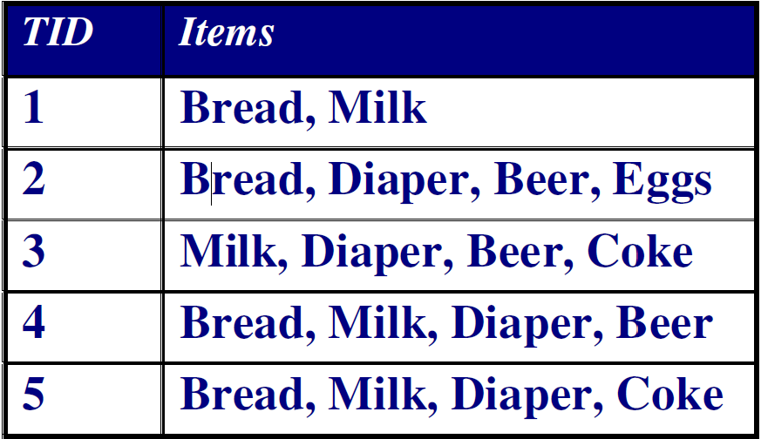
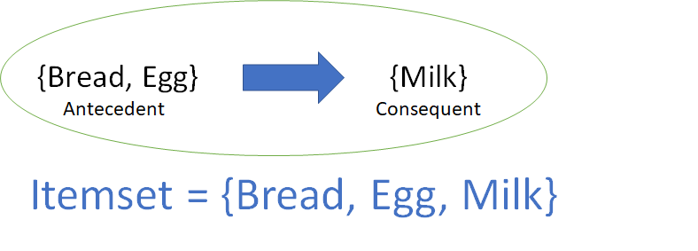
Market Basket Analysis cont’d
Each row in this table corresponds to a transaction, which contains a uniqueidentifier labeled TID
{Diaper} → {Beer}
{Milk, Bread} → {Diaper}
{Beer, Bread} → {Milk}
Itemset
A collection of one or more items
Example: {Milk, Bread, Diaper}
Notes:
You can see that Diaper is bought with Beer in three transactions. Similarly, Bread is bought with milk in three transactions making them both frequent item set
Given a database of transactions, find rules that will predict the occurrence of an item based on the occurrences of other items in the transaction.
We are interested in finding all rules,

Slide 6
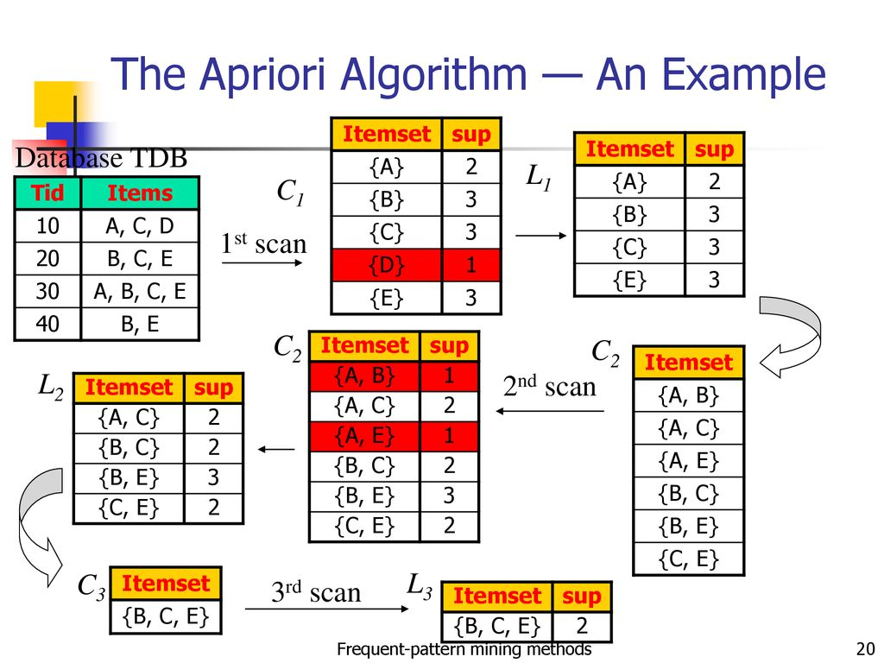
Apriori Algorithm
Named Apriori because it uses prior knowledge of frequent itemset properties
An iterative algorithm which looks for so-called frequent itemsets, which are representatives of sets of items that occur together in transactions
Lists are notated with ‘L’ and ‘C’, which stands for ‘Large Itemset’ and ‘Candidate Itemset’
It is assumed that the support of a frequent itemset is equal to or greater than a certain minimum support.
Frequent itemsets are used to create association rules whose confidence is greater than or equal to a predefined minimum
Notes:
-There are many different algorithm for Association Rule Mining but Apriori is one of the most common algorithm used
-Iterative algorithm that scans item list and finds frequent itemsets
-Frequent Itemsets are items that occur together in transactions
- Example:
-Frequent itemsets are used to create association rules

Slide 7
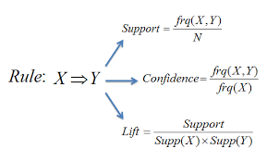
Apriori Measurements
Apriori primarily uses 3 measurements to generate association rules
Support: Measures how popular an itemset is
Confidence: Measures how likely item Y is purchased when item X is also purchased
Lift: Measures how likely item Y is purchased when item X is purchased, while controlling for how popular item Y is
Support is used to generate frequent itemsets
Confidence & Lift are used to generate association rules
Notes:
What are the calculations used to generate the rules?
Go through measurements in detail in next several slides

Slide 8

Support
Transactions
C1
Indicates the proportion of transactions in the dataset of all transactions containing
Items are a candidate if they meet the support threshold
Large itemsets are cross joined to generate association rules
Example:
10 transactions, 5 products
Minimum Support Threshold = 30%
Minimum Confidence Threshold = 60%
Basket | Product 1 | Product 2 | Product 3
1 | Peanut Butter | Jelly | Bread
2 | Bananas | Apples
3 | Peanut Butter | Jelly | Bread
4 | Apples | Bananas
5 | Peanut Butter | Jelly
6 | Bananas | Jelly | Apples
7 | Peanut Butter | Bread
8 | Bread | Apples | Bananas
9 | Bread | Peanut Butter | Jelly
10 | Peanut Butter | Apples | Jelly
Product | Number of Baskets | Support
Peanut Butter | 6 | 60%
Apples | 5 | 50%
Jelly | 6 | 60%
Bananas | 4 | 40%
Bread | 5 | 50%
Notes:
Measures how popular an itemset is and is used in the 1st step of apriori rule, which is to find frequent itemsets
Probability that 1, 2, 3 or more items appear in a transaction
Step1 : Calculate support by obtaining frequency of each products. This is called frequent itemsets
Step2: Remove candidates that fail minimum support count. The remaining list is Large itemsets
Example: Peanut butter appears 6 times in 10 transactions so it has 60% support -- numbers won't be nice

Slide 9
Support
L2
C2
Item 1 | Item 2 | Frequency | Support
Peanut Butter | Jelly | 5 | 50%
Peanut Butter | Bread | 4 | 40%
Peanut Butter | Apples | 1 | 10%
Peanut Butter | Bananas | 0 | 0%
Jelly | Bread | 3 | 30%
Jelly | Apples | 2 | 20%
Jelly | Bananas | 1 | 10%
Bread | Apples | 1 | 10%
Bread | Bananas | 1 | 10%
Apples | Bananas | 4 | 40%
Itemset | Frequency | Support
{Peanut Butter, Jelly} | 5 | 50%
{Peanut Butter, Bread} | 4 | 40%
{Jelly, Bread} | 3 | 30%
{Apples, Bananas} | 4 | 40%
Generate 2nd & 3rd candidate by cross joining products and calculating support
Continue to remove candidates that fail the minimum support count
First step of Apriori mining is complete as we did not have a transaction with 4 products
5 itemsets satisfied the 30% Threshold
L3
C3
Item 1 | Item 2 | Item 3 | Frequency | Support
Peanut Butter | Jelly | Bread | 3 | 30%
Peanut Butter | Jelly | Apples | 1 | 10%
Peanut Butter | Jelly | Bananas | 0 | 0%
Peanut Butter | Bread | Apples | 0 | 0%
Peanut Butter | Bread | Bananas | 0 | 0%
Jelly | Bread | Bananas | 0 | 0%
Jelly | Bread | Apples | 0 | 0%
Bananas | Apples | Bread | 1 | 10%
Bananas | Apples | Jelly | 1 | 10%
Itemset | Frequency | Support
{Peanut Butter, Jelly, Bread} | 3 | 30%
Frequent Itemsets
Itemset | Frequency | Support
{Peanut Butter, Jelly} | 5 | 50%
{Peanut Butter, Bread} | 4 | 40%
{Jelly, Bread} | 3 | 30%
{Apples, Bananas} | 4 | 40%
{Peanut Butter, Jelly, Bread} | 3 | 30%
Notes:
Repeat the steps in itemsets of 2 and 3
Large itemsets starting with 2 are candidates for association rules

Slide 10
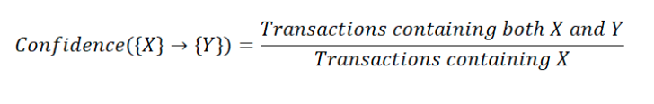
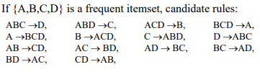
Confidence
Frequent Itemsets
Conditional probability that given x is present, y will also be present
Confidence metric is not symmetric or directed; for instance, the confidence for X->Y is different than the confidence for Y->X
This is compared to the confidence threshold and eliminated if support does not meet threshold
Item set is considered a strong rule if it satisfies the support and confidence thresholds
Misrepresenting the importance of an association is a drawback
Itemset | Frequency | Support
{Peanut Butter, Jelly} | 5 | 50%
{Peanut Butter, Bread} | 4 | 40%
{Jelly, Bread} | 3 | 30%
{Apples, Bananas} | 4 | 40%
{Peanut Butter, Jelly, Bread} | 3 | 30%
Candidate Rules
Itemset | Frequency | Support | Confidence
{Peanut Butter -> Jelly} | 5 | 50% | 83%
{Peanut Butter -> Bread} | 4 | 40% | 67%
{Jelly -> Bread} | 3 | 30% | 50%
{Apples -> Bananas} | 4 | 40% | 80%
{Jelly -> Peanut Butter} | 5 | 50% | 83%
{Bread -> Peanut Butter} | 4 | 40% | 80%
{Bread -> Jelly} | 3 | 30% | 60%
{Bananas -> Apples} | 4 | 40% | 100%
{Bread, Peanut Butter -> Jelly} | 3 | 30% | 75%
Jelly, Peanut Butter -> Bread} | 3 | 30% | 60%
{Bread, Jelly -> Peanut Butter} | 3 | 30% | 100%
11 possible rules were generated from the frequent itemsets
10 rules satisfied the minimum confidence threshold of 60%
Notes:
Confidence measurement is Conditional probability - probability of y being bought when x is bought
Not symmetric - confidence of y,x is different than xy
2nd row - Bread & Peanut butter appear in 4 transactions resulting in 40% support
PB is in 6 transactions - probability of bread being bought when PB is bought is 4/6 = confidence of 67%
6th row
Bread is in 5 transactions - probability of PB being bought when bread is bought is 4/5 = confidence of 80%
After all confidence calculated, does it meet confidence threshold? 3rd row fails
7th row, prob of jelly bought when bread is bought meet the confidence threshold
Confidence measurement doesn’t consider how popular the associated item is

Slide 11
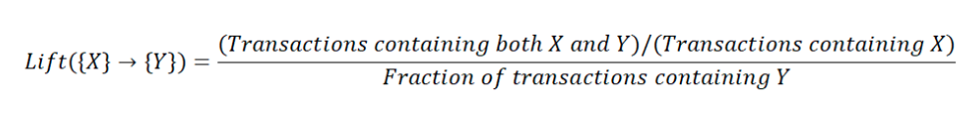
Lift
Lift is defined as the ratio of the confidence to the unconditional probability of the consequent B
Measures the correlation between item sets in the rule. Correlation shows how item set X effects the item set Y
Interpreting lift:
If the lift is greater than 1, then X & Y are dependent
If the lift is less than 1, then X will have negative effect on Y
If the lift is equal to 1, then X and Y are independent
Rules that are considered dependent are “interesting”
Itemset | Frequency | Support | Confidence | Lift
{Peanut Butter -> Jelly} | 5 | 50% | 83% | 1.39
{Peanut Butter -> Bread} | 4 | 40% | 67% | 1.33
{Apples -> Bananas} | 4 | 40% | 80% | 2.00
{Jelly -> Peanut Butter} | 5 | 50% | 83% | 1.39
{Bread -> Peanut Butter} | 4 | 40% | 80% | 1.33
{Bread -> Jelly} | 3 | 30% | 60% | 1.00
{Bananas -> Apples} | 4 | 40% | 100% | 2.00
{Bread, Peanut Butter -> Jelly} | 3 | 30% | 75% | 1.25
{Jelly, Peanut Butter -> Bread} | 3 | 30% | 60% | 1.20
{Bread, Jelly -> Peanut Butter} | 3 | 30% | 100% | 1.67
9 rules were considered interesting as they had a lift greater than 1
Notes:
its a measure to check whether this rule is in the list by random chance or expected
Calculation is confidence of rule / support of the associated item
Jelly in Jellyville NY might be popular while bread is not very popular. Everytime bread was bought, jelly was bought -> excluded if jelly is popular
Overall Apriori Consists of 2 steps
1) Generate all frequent itemsets whose support >= threshold
2) Use frequent itemsets to generate association rules

Slide 12
MBA - R Implementation
R includes apriori implementation in arules package
Calls the C implementation of the Apriori algorithm by Christian Borgelt
arulesViz allows to visualize rules

Slide 13
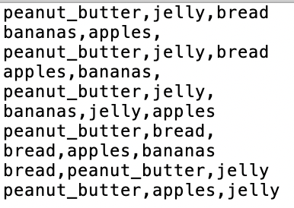
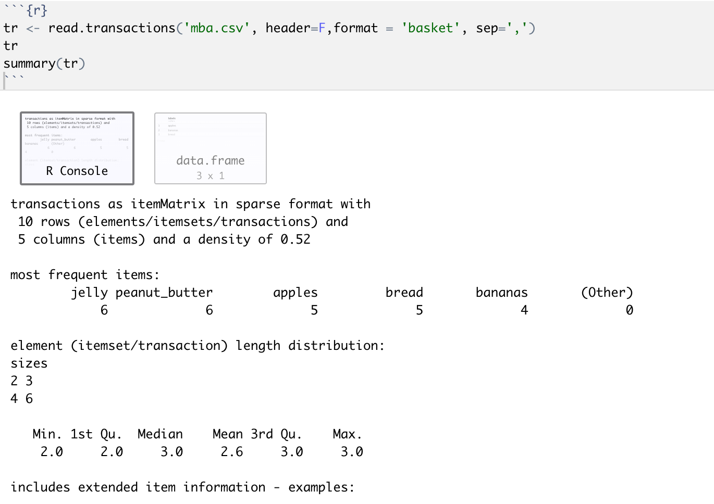
MBA - R Implementation
Data format
read.transactions() to read data in
summary()
most frequent items in the data set
transaction length distribution
extended transaction info

Slide 14
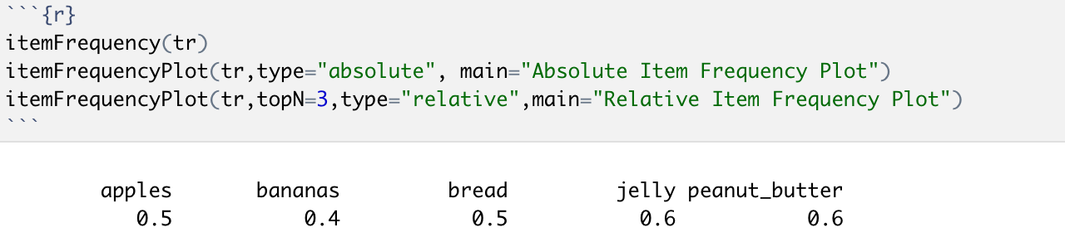
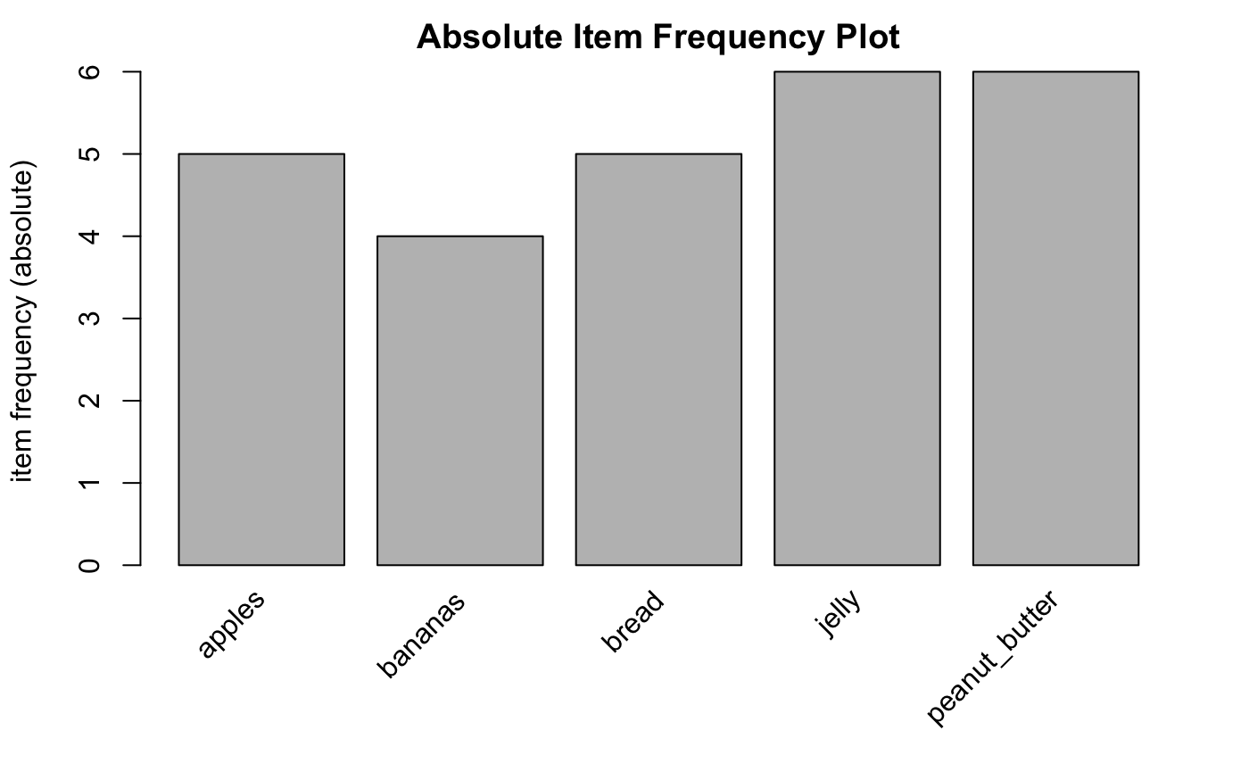
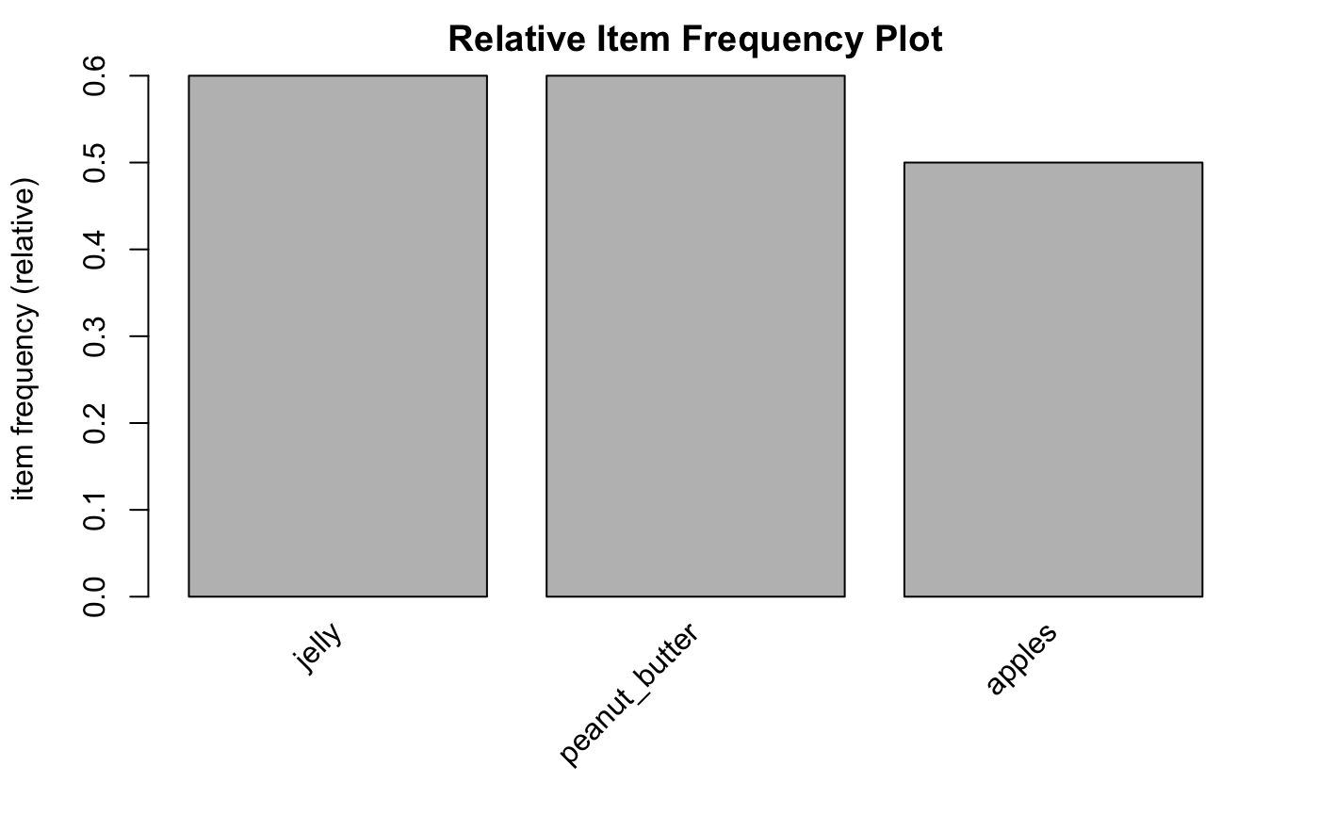
MBA - R Implementation
itemFrequency() calculates the frequency for each item in an itemMatrix
itemFrequency() also used by itemFrequencyPlot() to produce a bar plot of item count frequencies or support

Slide 15
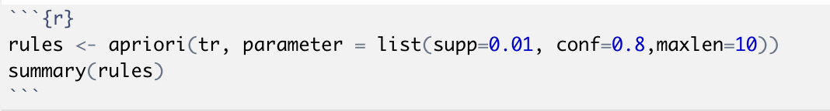
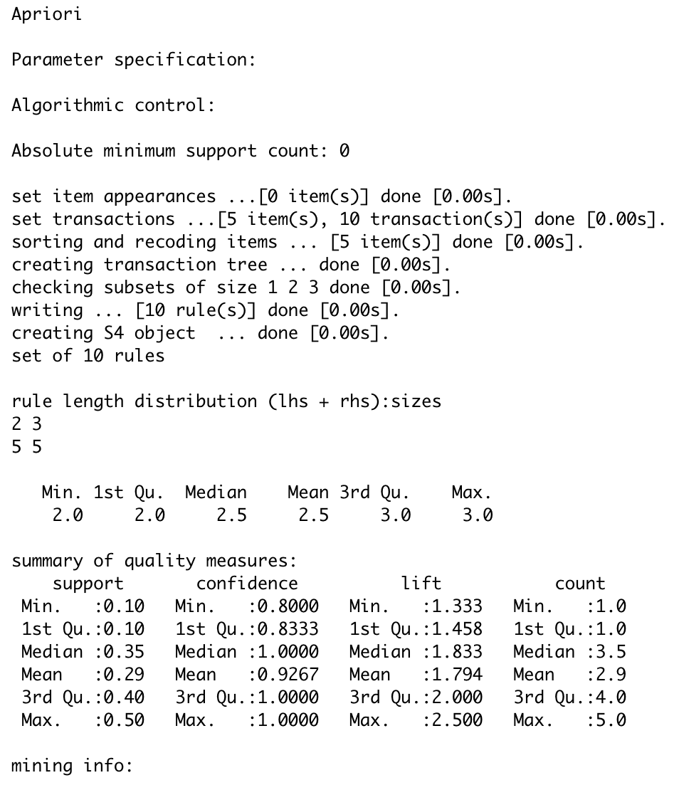
MBA - R Implementation
apriori() finds all rules
Takes parameters
maxlen = maximum size of mined frequent itemsets (default to 5)
Output of the C implementation with timing
Number of rules
Most frequent items in the LHS and the RHS and length distributions
Summary statistics of quality measures

Slide 16
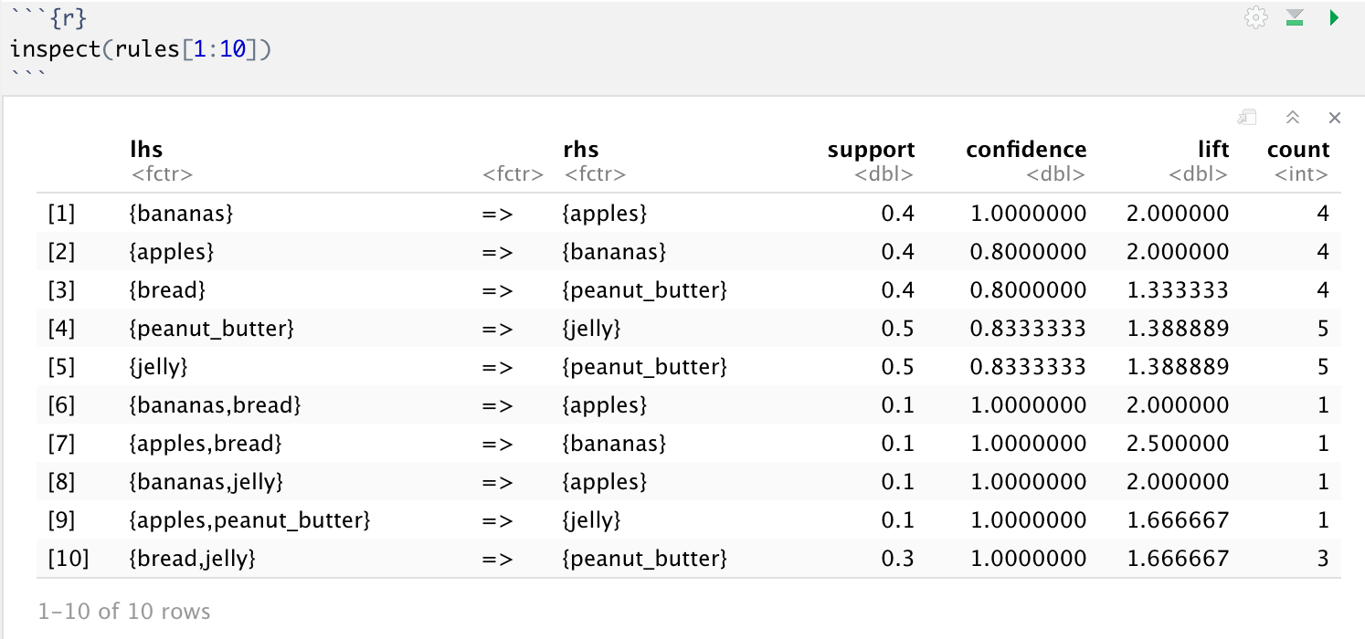
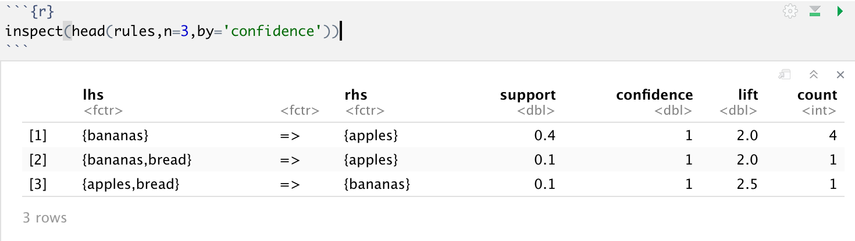
MBA - R Implementation
inspect() allows to view the rules
Can be customized for specific selection

Slide 17
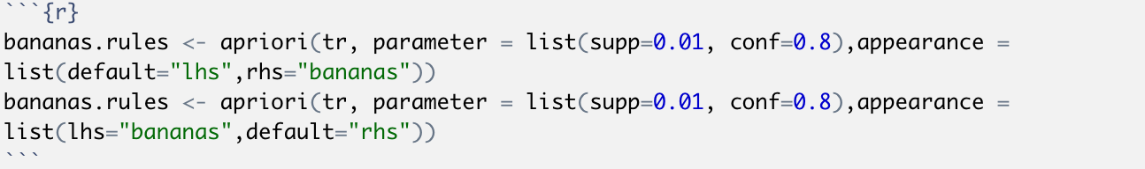
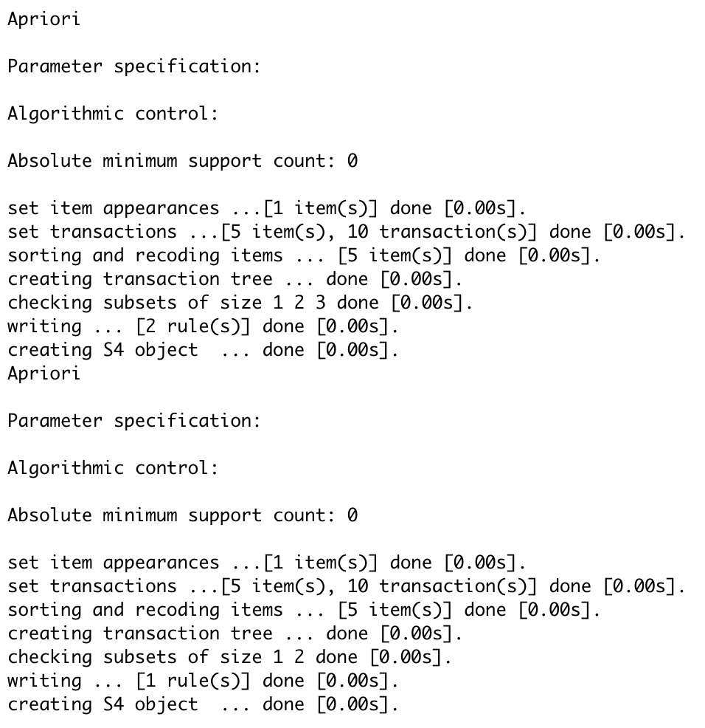
MBA - R Implementation
Specific product
appearance

Slide 18
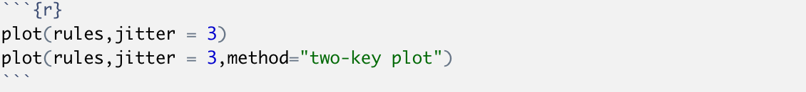
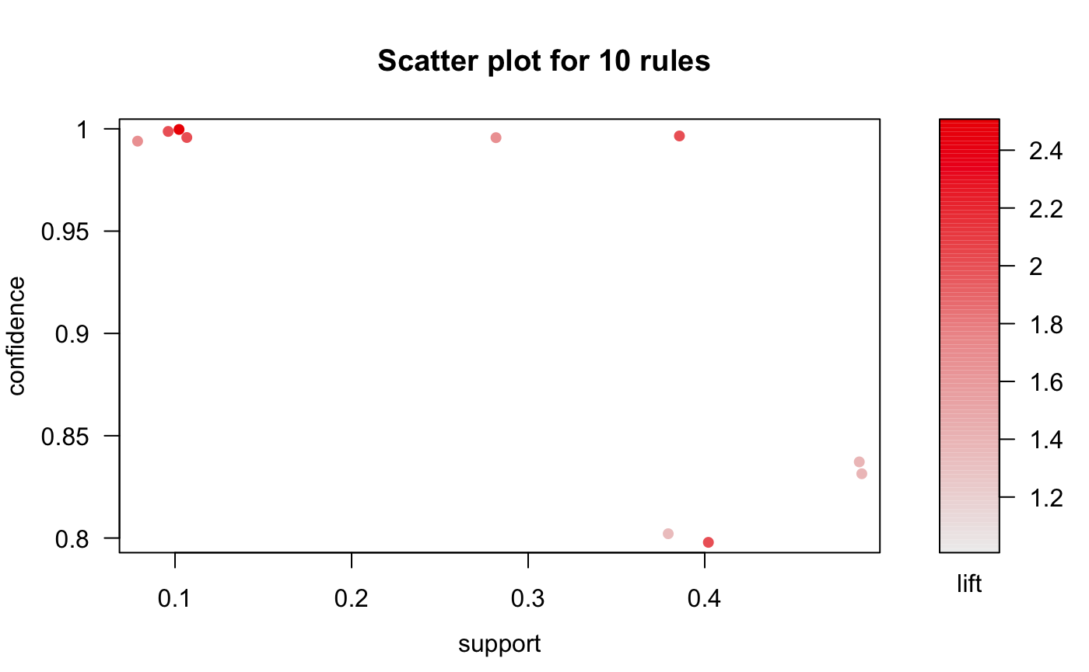
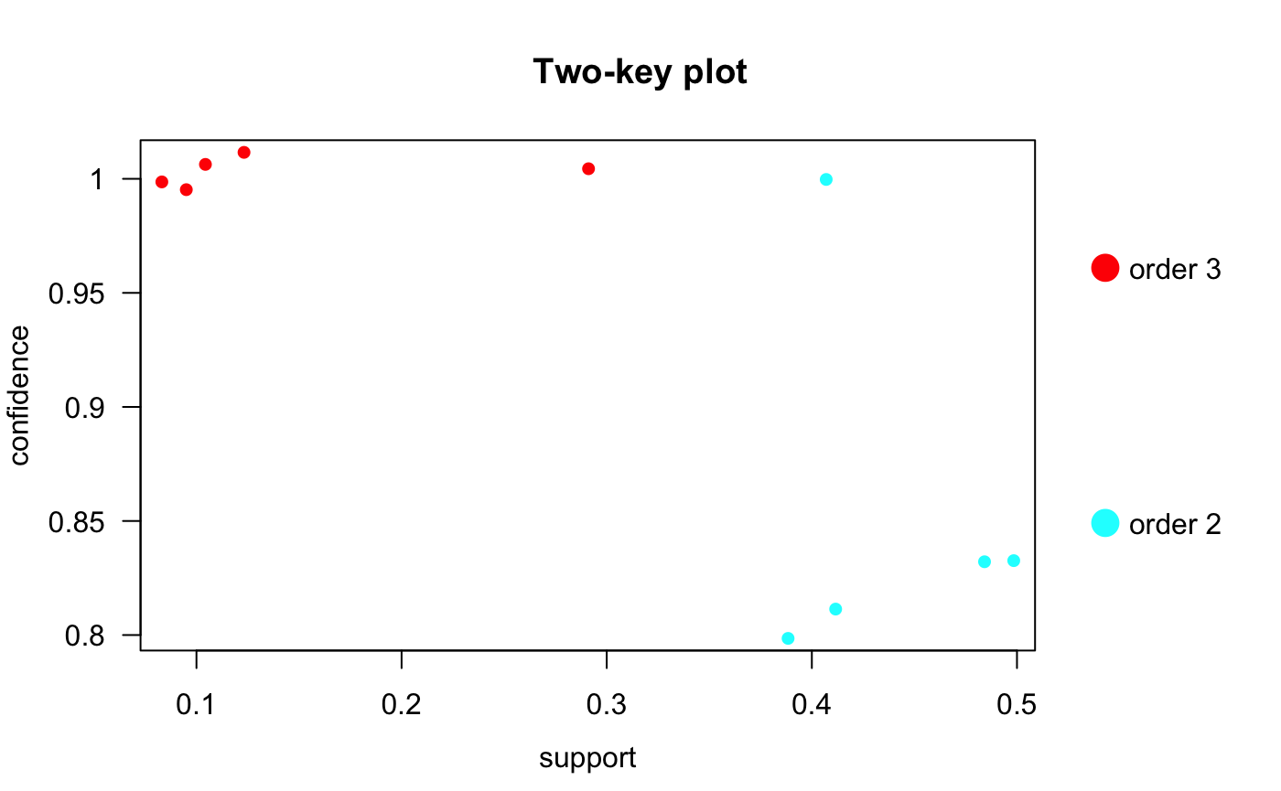
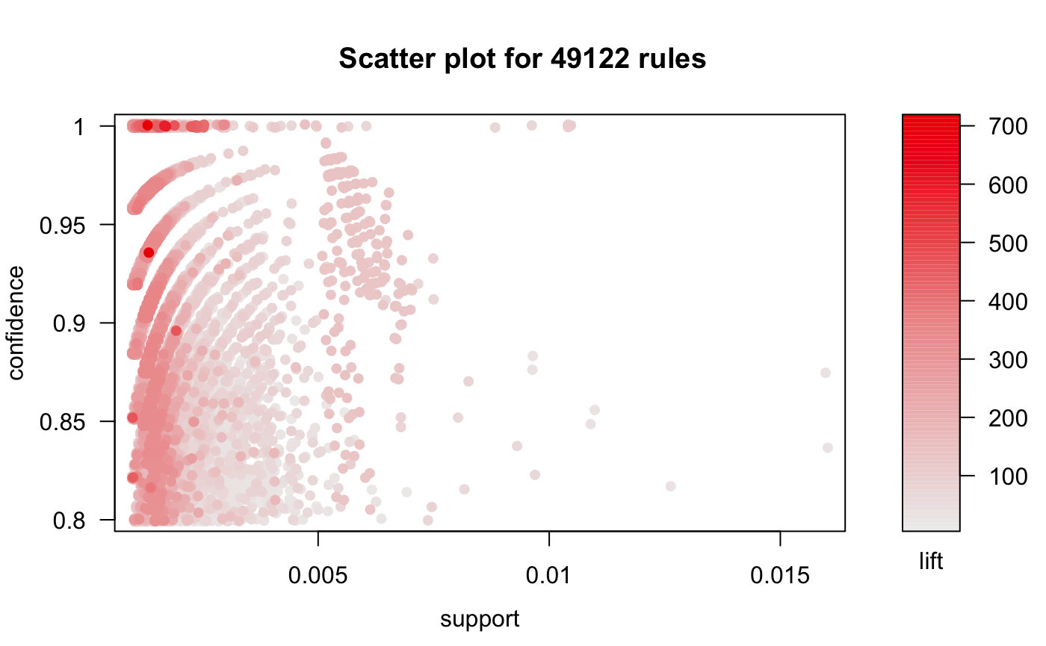
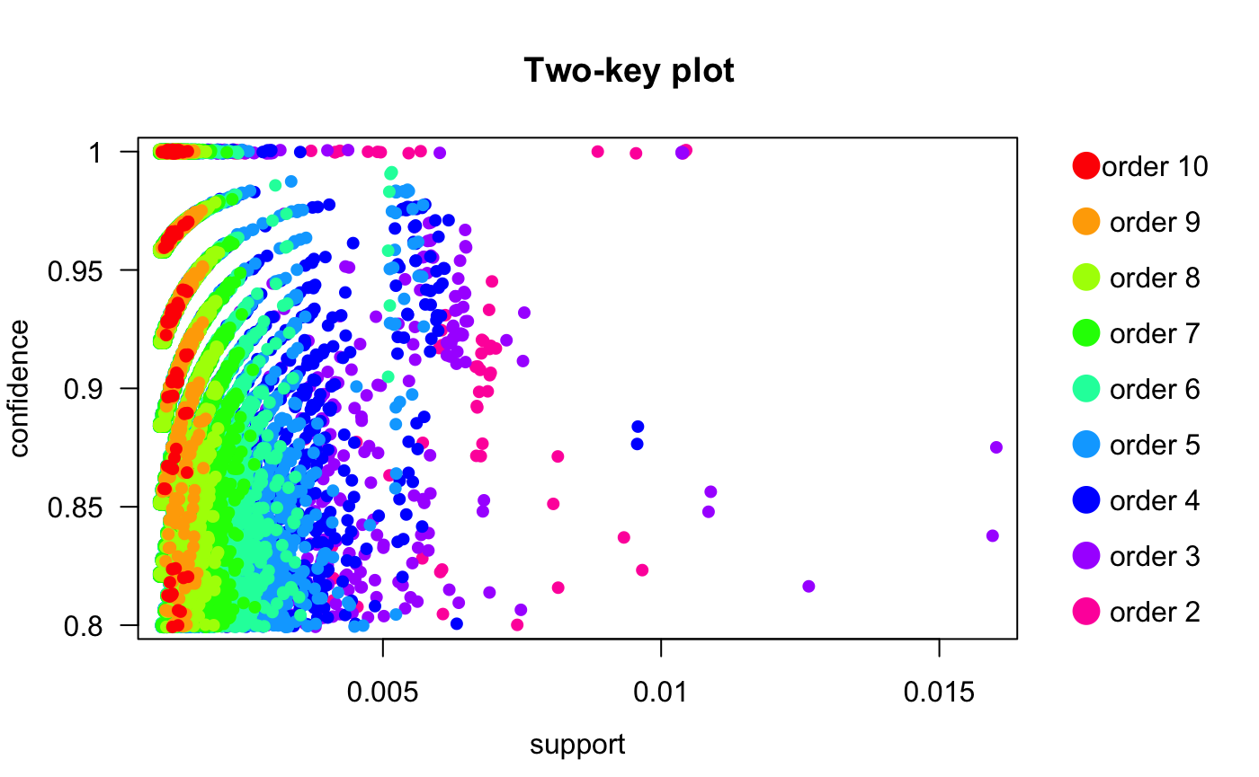
MBA - R Implementation
Scatter plot with two interest measures on the axes
Rules with high lift have typically a relatively low support
Special version - Two- key plot
“order” = the number of items contained in the rule
Notes:
Most interesting rules typically reside on the support/confidence border
Any measure stored in the quality slot of the set of rules can be used for the axes
Order and support have inverse relationship

Slide 19
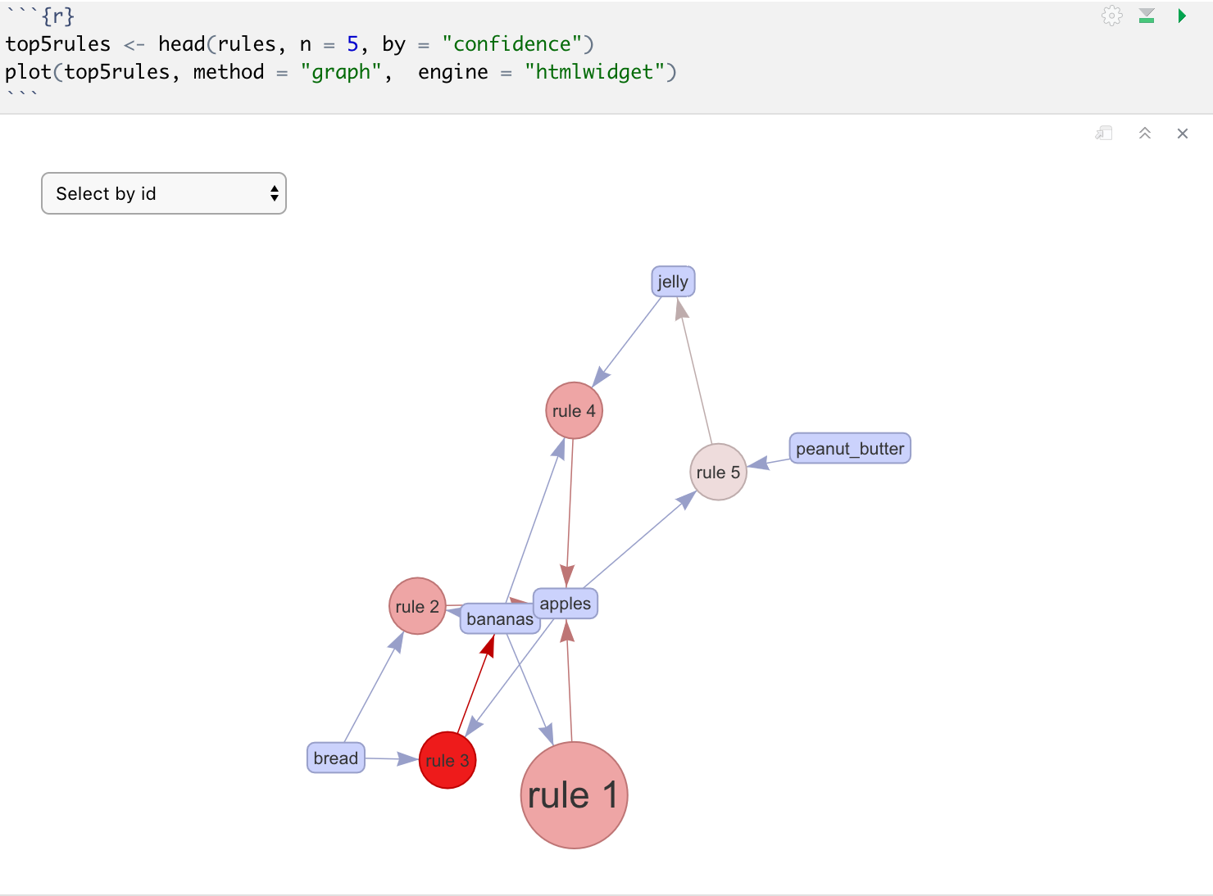

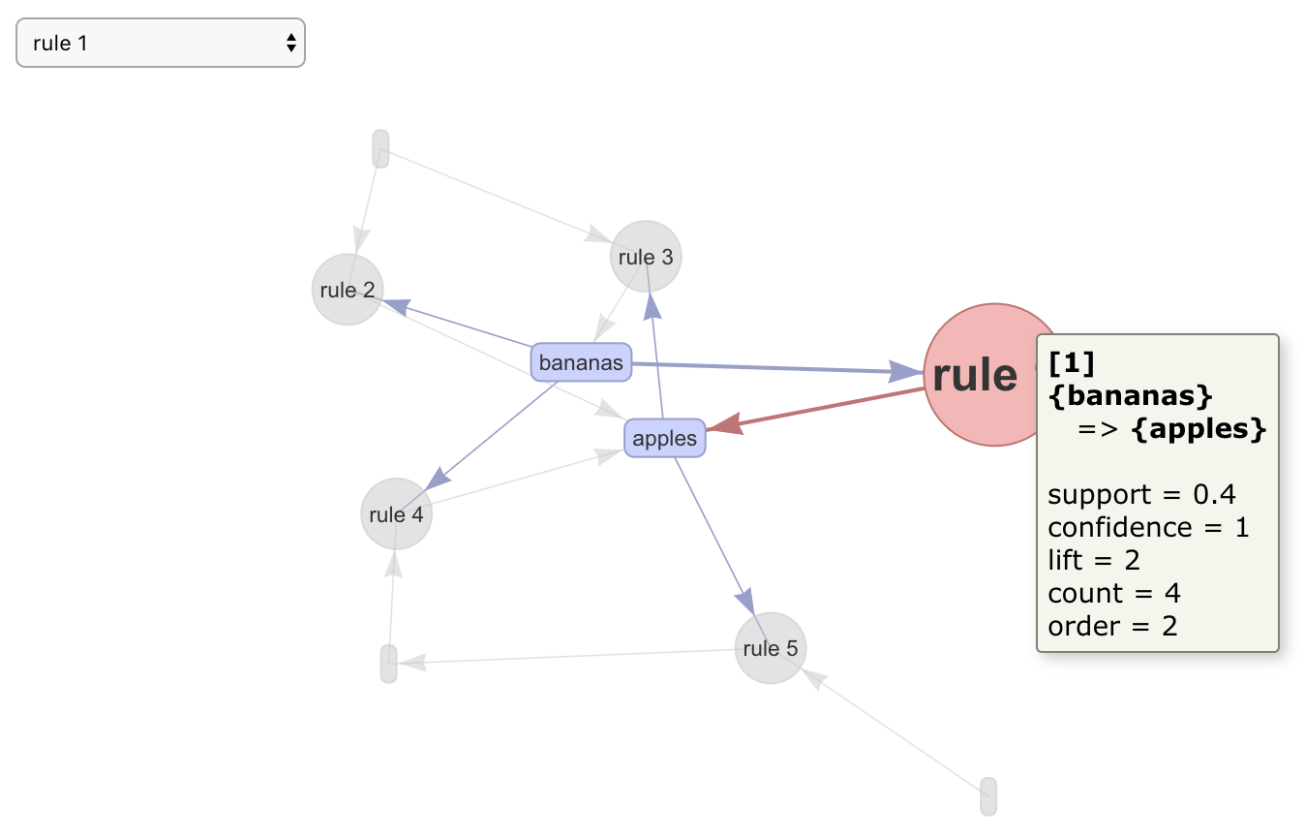
MBA - R Implementation
Graph methods
vertices represent items
itemsets or rules as a second set of vertices
Arrows pointing from items to rule vertices indicate LHS
Arrow from a rule to an item indicates the RHS
Interest measures added to the plot by using color/size of the itemsets/rules vertices

Slide 20
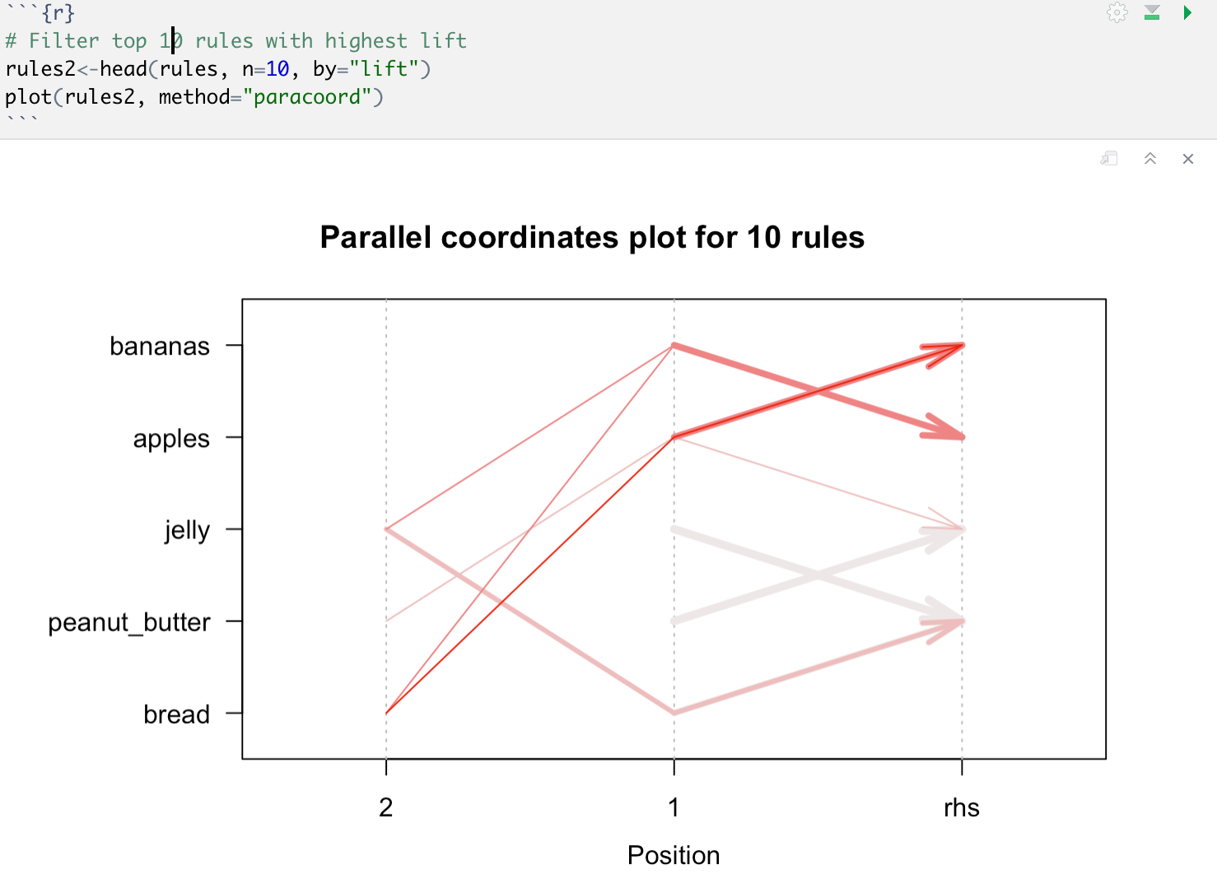
MBA - R Implementation
Designed to visualize multidimensional data
Each data point is represented by a line connecting the values for each dimension
Items on the y-axis are nominal values
x-axis represents the positions in a rule
arrow is used where the head points to the consequent item
Notes:
Designed to visualize multidimensional data where each dimension is displayed separately on the x-axis and the y-axis is shared
x-axis represents the positions in a rule, i.e., first item, second item, etc

Slide 21
Conclusion
Pros | Cons
Easy interpretation Easy implementation Scalable Multiple applications | Support calculation is expensive Computationally expensive to find candidate rules Does not work with continuous variables

Slide 22
Resources
https://webfocusinfocenter.informationbuilders.com/wfappent/TLs/TL_rstat/source/marketbasket49.htm
https://bcssp10.files.wordpress.com/2013/02/lecture191.pdf
https://cran.r-project.org/web/packages/arules/arules.pdf
https://cran.r-project.org/web/packages/arules/vignettes/arules.pdf
https://cran.r-project.org/web/packages/arulesViz/vignettes/arulesViz.pdf
https://upcommons.upc.edu/bitstream/handle/2117/109798/129057.pdf?sequence=1&isAllowed=y
https://jmhldotorg.files.wordpress.com/2013/11/slidesinfosysbangaloreintroductionmba2011.pd
https://www.linkedin.com/pulse/introduction-market-basket-analysis-association-rule-abhishek-kumar/f

Slide 23
AR Algorithms
APRIORI : Apriori Algorithm proceeds by identifying the frequent individual items in the database and then extends them to larger and larger item sets as long as those item sets appear sufficiently often in the database
Eclat - uses a vertical database layout i.e. instead of explicitly listing all transactions ; each item is stored together with its cover (also called tidlist) and uses the intersection based approach to compute the support of an item set. It requires less space but it is suitable for small datasets
FP-growth : generates frequent item set without candidate generation. It uses a divide and conquer strategy while creating a tree based structure

